Slide 1
Project Vision AND Background
My vision over the development of this project is to create a graphical calculator that students would be able to use to aid them with the graphical side of mathematics , the main goal is to have an application where the user can visualize their functions and equations that they have inputted , showing keys points such as the turning point and when the line meets x and y . This goal is more of a baseline and would be the starting point for other ideas to be implemented, I have already produced many mathematical concepts that I could include within this single page application . These include trigonometric functions, matrix operations , unit conversion, integrations and differentiation, complex number operations and statistical calculations. I will most likely not be including all of these within my project, and I will evaluate how necessary and useful these applications are against the time it may take and the complexity of the project.
One of the fundamental reasons for me deciding to choose this project is my background in mathematics , I have always enjoyed and excelled in maths, therefore when I thought about a project that I could do that would both be beneficial and one that I would enjoy creating, creating a graphical calculator seemed like a good idea. I chose this part of mathematics because I always found graphs to be quite tedious, especially when reaching the end of GSCE higher and even more relevant in A level. So, I decided that creating an application that could help represent graphs and show aspects such as the turning point would be useful. As I have spoken about before I would like to include other mathematical concepts as a lot of these other concepts do link with graphs and having a single page application with multiple features in one place could be very helpful and efficient.

Slide 2
Project Plan and Sprints so far ( 1 )
Overall plan for the end of semester 1 is to finish the home page and start to develop a baseline application I can use to then start building off, this will be a basic a graphical calculator that will take in an equation, y = 2x for example, and then visualize this in the form of a line within the canvas. I will build upon this after Christmas, adding more parts such as the x and y lines and the ability to see certain details about the line such as when it meets the y and x axis.
Sprint 1:
- create a homepage for my webpage ( this could include a design for how I want it to look )
- homepage will be basic with a short description of what my SPA will contain
- research graphs and lines in web development
- start creating the graphical interface for my calculator
- want to have a place you can input equations
- want to have a canvas where the line will be outputted (no JavaScript yet so no function)
Sprint 2:
- start developing the JavaScript and function of my calculator
- be able to take equations in the form of y = something x ( 2 * x , 2 + 2x etc )
- output these equations taken in , in the form of a line
- make sure that these are outputted within the boundaries of the canvas
- have a simple baseline graphical calculator that can be expanded upon and with full functionality

Slide 3
Project Plan and Sprints so far ( 2 )
Sprint 1: Problems that may be faced
- the homepage needs to be user-friendly and be aesthetically pleasing, this may take time and others' opinions to make sure my homepage meets these conditions
- the homepage needs to be properly styled and tidy using CSS , trial and error may need to be used to make sure everything looks tidy (this will be more of a problem once I add my application to the page)
- avoiding the use of libraries will make coding my project more time-consuming , learning the graphical side of web development may also take time
- validating and handling user input will be complex as I will need to output the appropriate errors and handle any input that could be inputted
- will need to research canvas api , might take extensive research and testing
Sprint 2: Problem that may be faced
- there may be different forms of input that could cause issues such as 2x and 2 * x , will need to make sure any form can be inputted
- drawing a line on the canvas can be quite difficult and the correct algorithm will need to be chosen for this
- will need to make sure that the output is clean and stays within the given boundaries, as well as not overlapping previous inputs

Slide 4
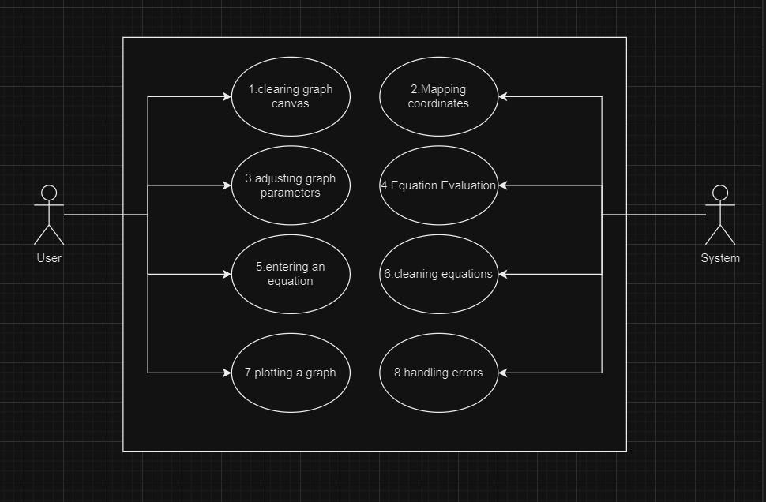
The system clears the graph canvas whenever a new equation is inputted and run using clearRect().
The system maps coordinates from the original mathematical range and converts this to the canvas space using coordinate_Mapper().
The user can change the value of the x value within the equation and update the graph according to this change.
The system evaluates the equation inputted to generate the x and y values using evaluate_Equation().
The user can input an equation in the form y = something x for it to be displayed onto the screen.
The system cleans inputted equations so it can be evaluated , such as 2x to 2 * x.
The user can input an equation and then request for this to be displayed onto the graph using plot_Graph().
The system detects errors during the graph plotting or the equation evaluating and sends appropriate feedback.
UML models so far
User Case Diagram

Slide 5
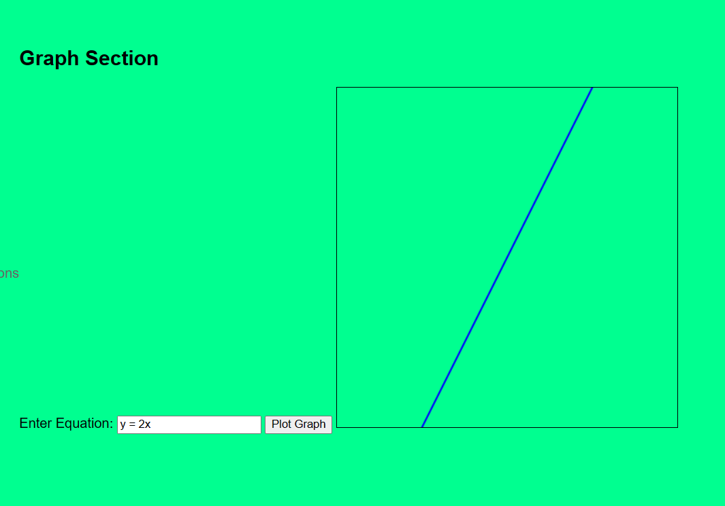
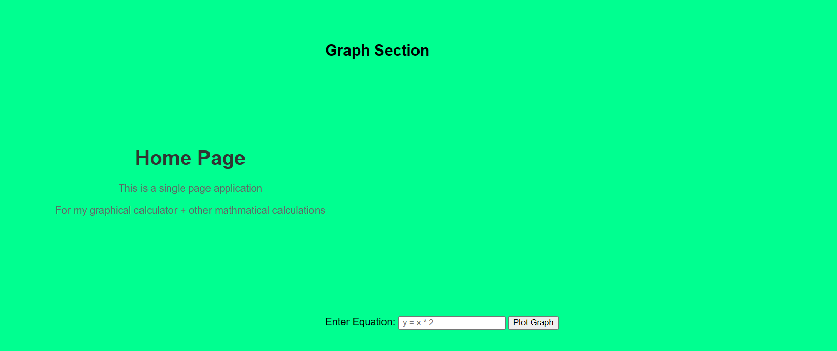
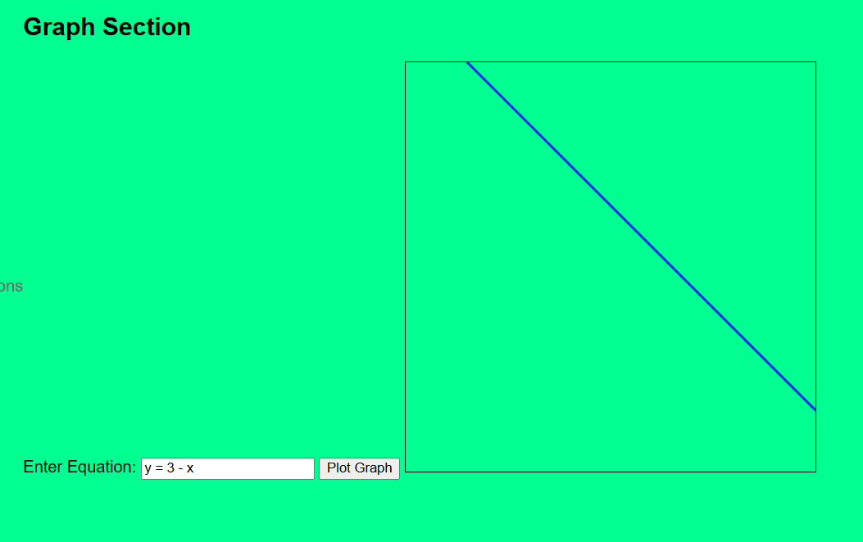
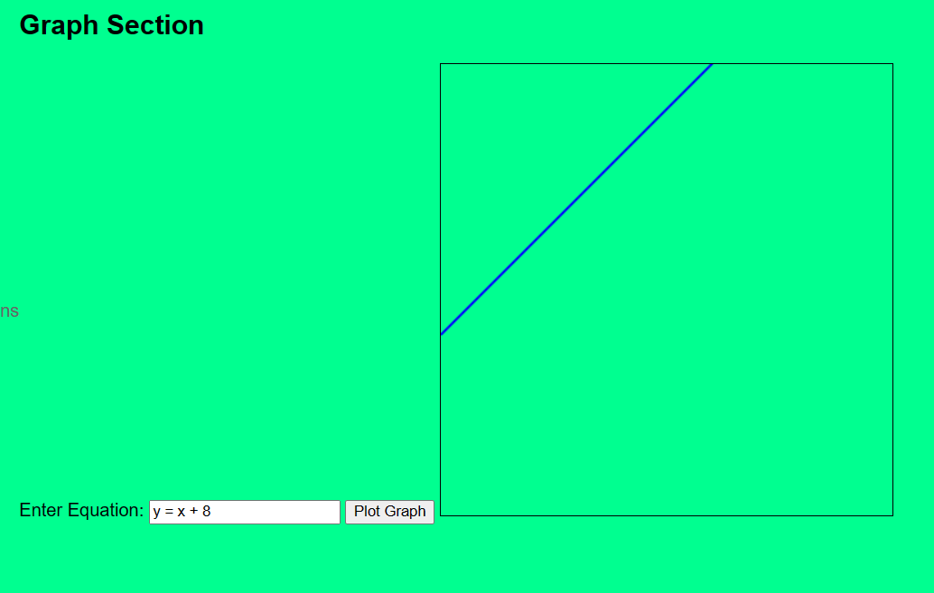
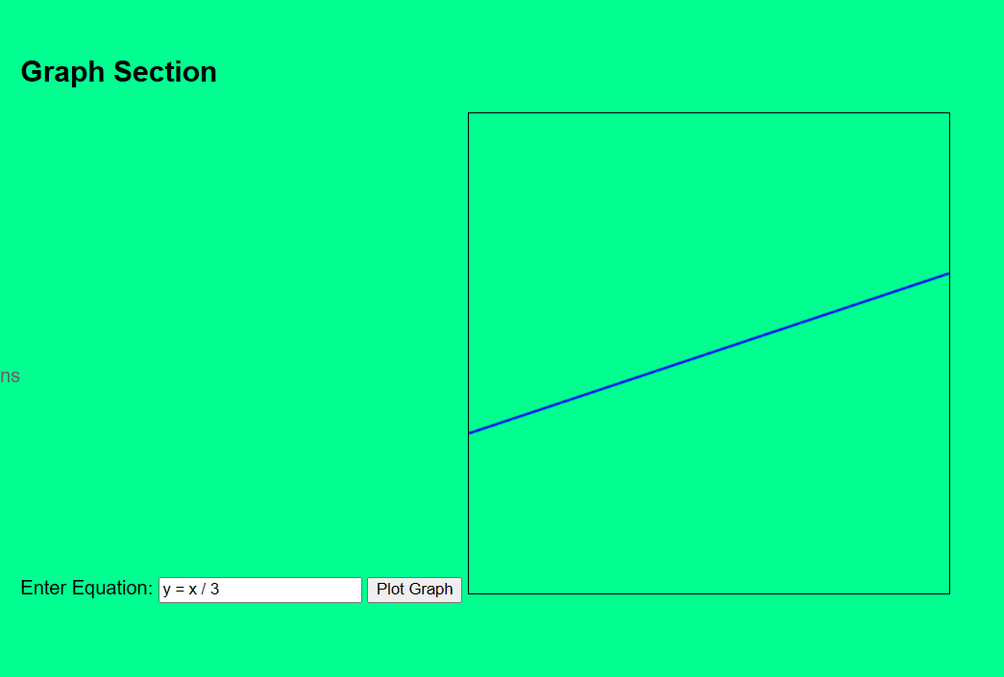
Prototype

Slide 6
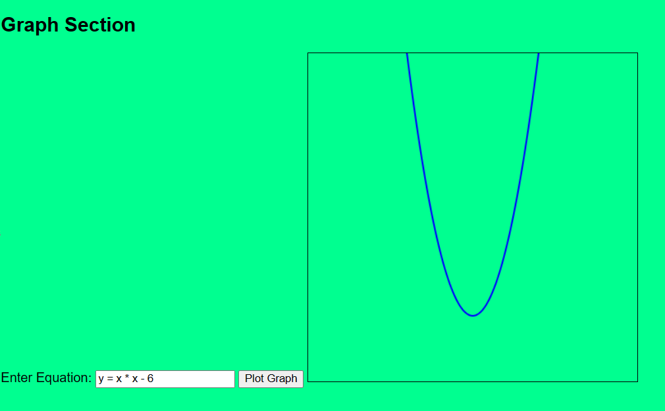
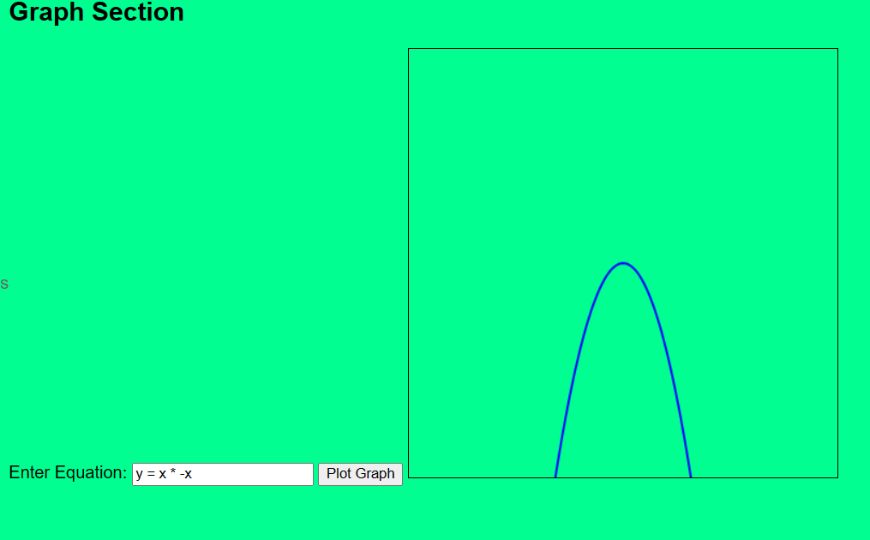
Prototype ( 2 )
This and the previous slide shows my prototype working, currently it can produce all these outputs . This is a very basic prototype and will be developed to a much higher standard in the coming sprints, I intend to include coordinates and the y and x axis onto the canvas , as well more develop to the equations that can be inputted.
This prototype is very unorganized now and will be tidied up in the future, it has just been created to show the functionality of my application and will be represented in a much more readable and tidier way further in development.
As I have said before this prototype is my baseline for my project and will be developed upon as well as allowing other applications to be made in future around this one.

Slide 7
Errors faced so far
[2 is not a function] This suggests there was an error when evaluating the equation ( y = 2 * x ) , indicating it could be a problem with the equation parsing or evaluation.
[y is not defined] An error occurred saying that the variable y was not defined in the equation evaluation , indicating it could be problem with how the equation was processed.
[x is not defined] An error occurred when plotting the graph , indicating it could be a problem with x not be defined in the equation evaluation.
[invalid left-hand side in assignment] An error occurred with the equation parsing / evaluation , especially with the left-hand side of the assignment.
[failed to load resource] An error occurred when trying to load my JavaScript file.
[unexpected token] This suggests there's a syntax error in my equation , this could be a misplaced parathesis.
[y is not defined] This error once again suggests that variable y was not defined in the equation evaluation.
[2 is not a function] Once again getting this error that shows there was a problem plotting the graph and a problem with the equation parsing or evaluation.
[invalid left-hand side in assignment] This error came up again showing there's a problem with the equation parsing / evaluation.
[y is not defined] Once again having problems with the variable y not being defined.
I have not included all my errors as many of them repeated several times and I also did not link my JavaScript file correctly which led to a lot of false errors that were only being caused because I had not linked the file and copied out the name of my incorrectly. I would say the most challenging part was figuring out to allow inputs such as 2x, in the end I made it to the input would be cleaned and converted into a input that could be processed, such as 2x to 2 * x.

Slide 8
Errors faced so far and how I fixed them (2)
I adjusted the equation evaluation in the evaluate_Function , I sanitized the equation and then used the Function constructor as I believed this was a safer option for evaluation.
Defined y correctly in the evaluate_Function.
Defined the variable x correctly within the evaluation process.
Corrected by making sure the correct syntax was used within evaluate_Function by correctly formatting it for evaluation.
Correctly referenced by JavaScript file.
Changed a misplaced parathesis.
This error was fixed by something else I did, I think it was correcting the evaulate_function once again but I am not sure.
Refined the equation_function by sanitizing the equation, something went wrong in my cleaning function and fixed it.
9 + 10 were like how I fixed them before.
Overall, I had few errors with the graphical side and rather the biggest problem was the inputs and the evaluate function. Making sure the output was within the canvas was fine, however I did have some problems with showing the box for the output , but this was only because of a typo. In the future I need to make sure there are no typos within variables and functions between my files as this caused quite a few unnecessary problems that could have been fixed if I was more careful whilst writing my code.

